Slide 1
Accounting masters
Presented by S.R.Zameer

Slide 2
List/Chart of Accounts
There are 28 Groups Pre-defined available by default in Tally.ERP9. Once you create company, from Gateway of Tally go to Display>List of Accounts to see all the 28 Groups. These Primary Groups can't be deleted, however, you can rename but it is not suggested.
I recommend, first you should create List/Chart of Accounts according to your business requirement then you create Groups & Ledgers.

Slide 3
Contd…
I have created List/Chart of Accounts which may be suitable to all types of business as shown below:

Slide 4
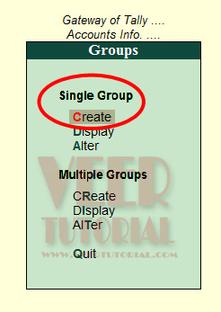
Create Group in Single Mode
For creating Single Group, from Gateway of Tally go to Accounts Info>Groups>Single Group-Create Press enter.

Slide 5
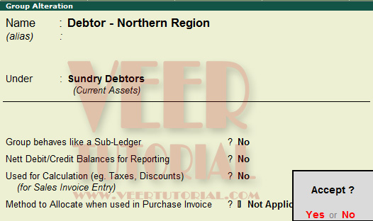
Group Creation screen will appear as shown below:

Slide 6
Contd…
Its Groups creation screen in advanced mode. if you see a small screen with less option. Press F12 for configuration, Select 'Yes' in Allow ADVANCED entries in masters.
Name Enter the name of the Group you want to create.
Alias Enter the alias name in addition to its name, or leave it blank. For example, you can enter DNR as shortcut name for Debtor - Northern Region
Under Select the appropriate Group name from the list (right hand side). For Example, Sundry Debtor in this case
Group behave like Sub-Ledger If you Select 'No' to this option, it will allow you to display all ledger under this group in detailed mode. But if you select 'Yes' to this option, it will not allow to display ledger under this group but it will behave as ledger and will display total balance figure of all ledger under this group

Slide 7
Contd…
Nett Debit/Credit Balances for Reporting? If this is set to 'No', both debit and credit balances will be displayed in the report otherwise it will display either the net debit or credit balance in the report (whichever is higher).
Used for Calculation Set this option to Yes if ledgers under this group would have percentages for discounts/taxes to be used in invoice entry. This gets reflected while passing voucher entry in Invoice mode and for automatic calculations
Method to allocate when used in purchase invoice Select the appropriate allocation method from the list. This is used to allocate the expense of the Item in the ratio of the quantity or value

Slide 8
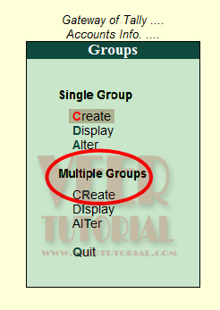
Create Groups in Multiple Mode
For creating Multiple Groups, from Gateway of Tally go to Accounts Info>Groups>Multiple Groups-Create Press enter.

Slide 9
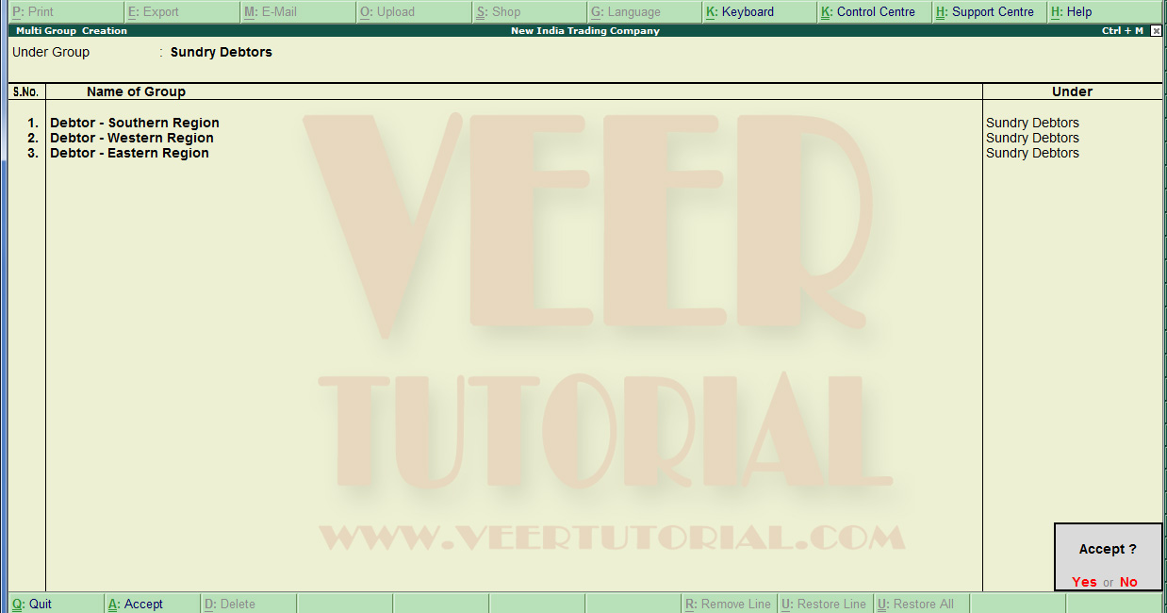
Group Creation screen will appear as shown below:

Slide 10
Contd….
Under Select the appropriate Group name from the list (right hand side). For Example, Sundry Debtor in this case
Name of Group Type the group name in this field
Debtor - Southern Region in this case. Press enter and again type the second name of group under the Sundry Debtor.

Slide 11
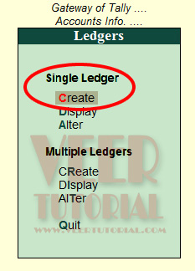
Create Ledger in Single Mode
For creating Single Ledger, from Gateway of Tally go to Accounts Info>Ledger>Single Ledger-Create Press enter.

Slide 12
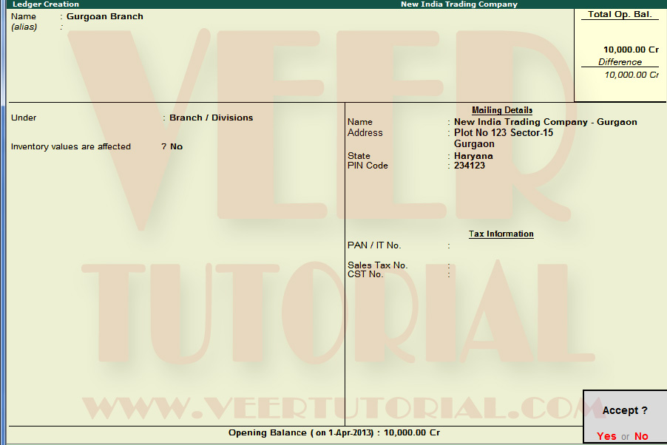
Ledger Creation screen will appear as shown below:

Slide 13
Contd…
Its Ledger creation screen in advanced mode. if you see a small screen with less option. Press F12 for configuration, Select 'Yes' in Allow ADVANCED entries in masters.
Name Enter the name of the Ledger you want to create. Gurgaon branch in this case
Alias Enter the alias name in addition to its name, or leave it blank. For example, you can enter GrnBr as shortcut name for Gurgaon Branch
Under Select the appropriate Group name from the list (right hand side). For Example, Branch / Divisions in this case

Slide 14
Contd….
Inventory values are affected Select 'Yes' to this option, if inventory value will be affect otherwise Select 'No'. Note: Inventory Value will be affected with Sales or Purchase Ledger only
Mailing Details Enter the all mailing details related to this ledger
Tax Information It is reccomand to enter all tax information because it will help to make necessary tax reports
Opening Balance Enter the opening balance (if any) Note: Becareful to select Dr/Cr balance

